Slide 1
Machine Learning Methods

Slide 2
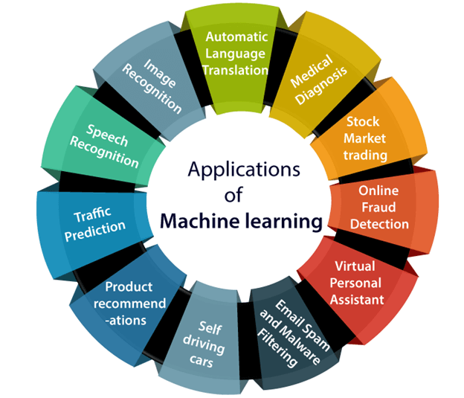

Slide 3
Outline
Machine learning methods
Coding examples

Slide 4
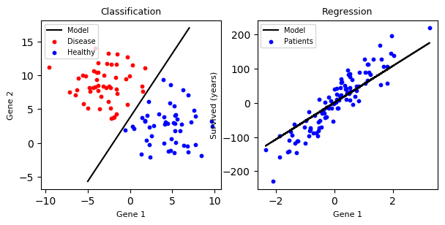
Classification vs Regression
Classification
Regression
The response variable is categorical
The response variable is numerical
The two terms are used interchangeably, but we need to remember the difference under the hood

Slide 5
Machine learning classification methods
Logistic regression
Decision trees
Random forest
Voting methods
Support vector machines
XGBoost
Linear regression
k-nearest neighbors

Slide 6
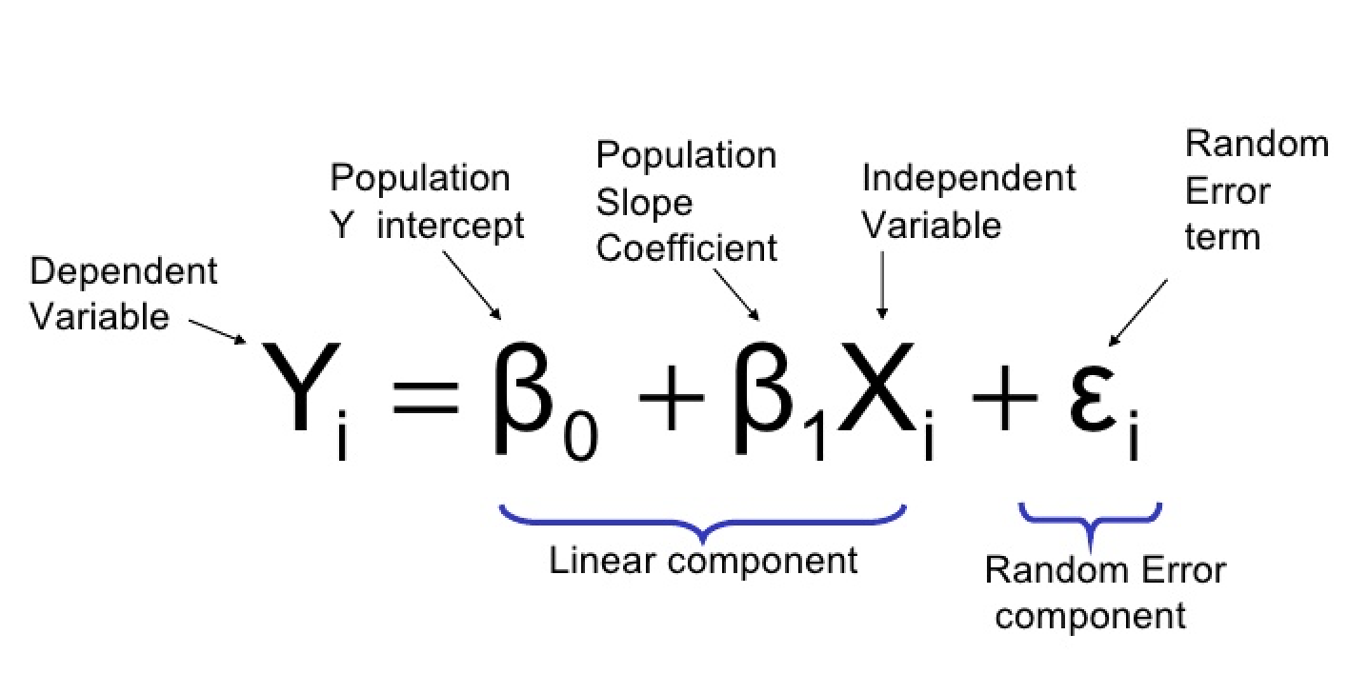
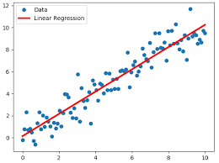
Linear regression models assume a linear relationship between the input variables and the output variable
Prediction is as simple as solving the equation for a specific set of inputs
Adapted from Linear Regression for Machine Learning , Linear Regression in Python

Slide 7
Generalized linear models
An extension of ordinary linear regression that allows response variable with a non-normal error distribution
Model | Probability distribution of response | Link function | Explanatory variables
Linear Regression | Normal | Identity | Continuous
ANOVA | Normal | Identity | Categorical
Logistic Regression | Binomial | Logit | Mixed
Multinomial response | Multinomial | Generalized Logit | Mixed
Adapted from https://online.stat.psu.edu/stat504/node/149/

Slide 8
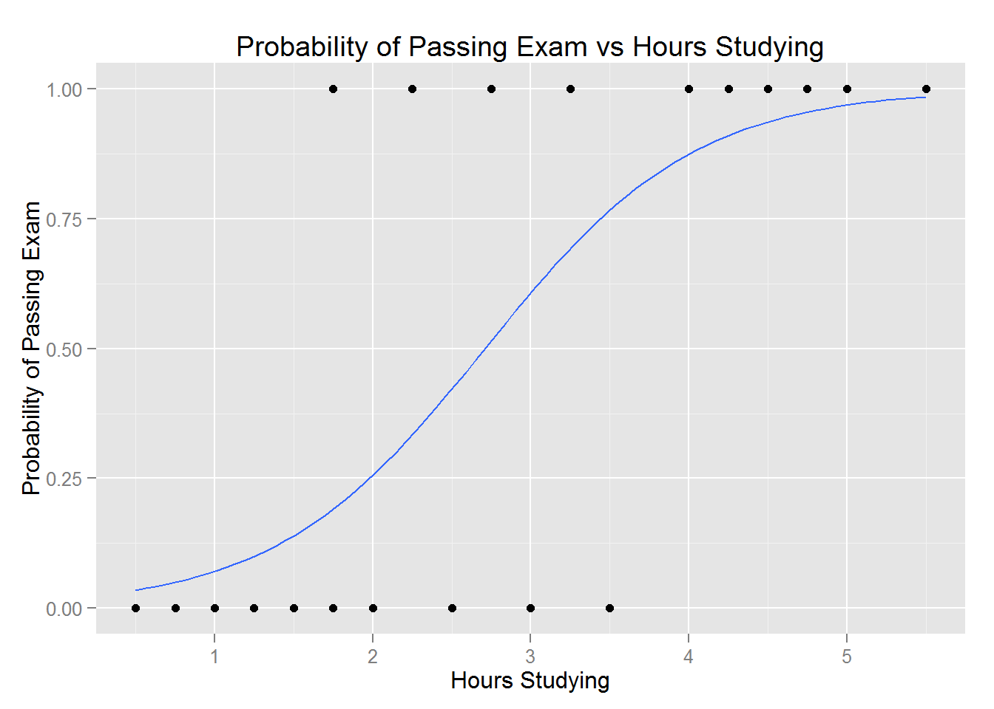
Logistic regression predicts the probability of a binary response taking a particular value
Example: A group of 20 students spend between 0 and 6 hours studying for an exam. How does the number of hours spent studying affect the probability that the student will pass the exam?
Hours of study | Probability of passing exam
1 | 0.07088985
2 | 0.25568845
3 | 0.60732935
4 | 0.87442903
5 | 0.96909067
Adapted from Example of Logistic Regression

Slide 9
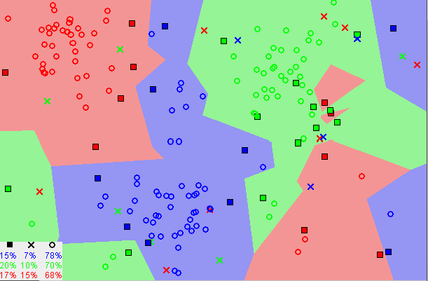
K-Nearest Neighbors
Similar things exist in close proximity
Adapted from How to measure distances in machine learning

Slide 10
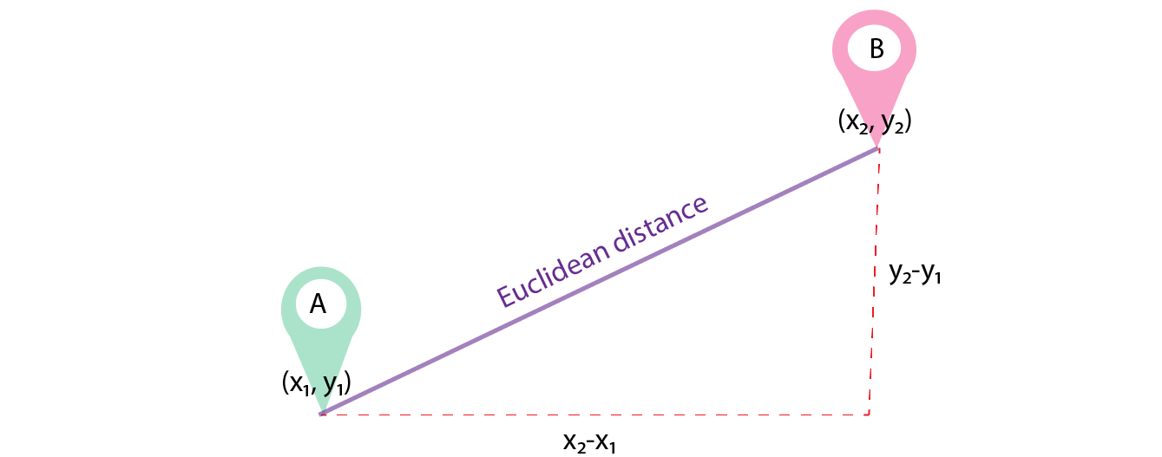
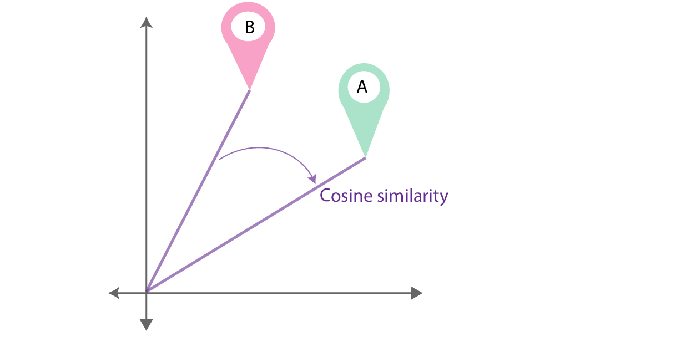
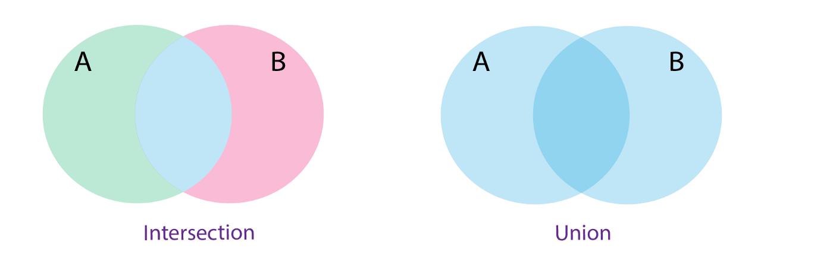
Similarity is usually defined as a distance between two objects
If the distance is small, the elements are likely similar. If the distance is large, the degree of similarity will be low.
Common distance metrics
Euclidean
Cosine
Jaccard
The length of a line segment connecting two points
The cosine of the angle between two vectors
The size of the intersection of 2 sets divided by the size of the union
Adapted from Machine Learning Basics with the K-Nearest Neighbors Algorithm

Slide 11
The K-NN algorithm is intuitive
Choose K, the number of neighbors
For a given data point:
Return the mode of the K labels
Calculate the distances between the given point and all other examples in the data
Sort the distances from smallest to largest (in ascending order)
Pick the first K entries from the sorted collection
Get the labels of the selected K entries
Adapted from Machine Learning Basics with the K-Nearest Neighbors Algorithm
Notes:
KNN works by:
finding the distances between a query and all the examples in the data
selecting the specified number examples (K) closest to the query
then votes for the most frequent label (in the case of classification) or averages the labels (in the case of regression).

Slide 12
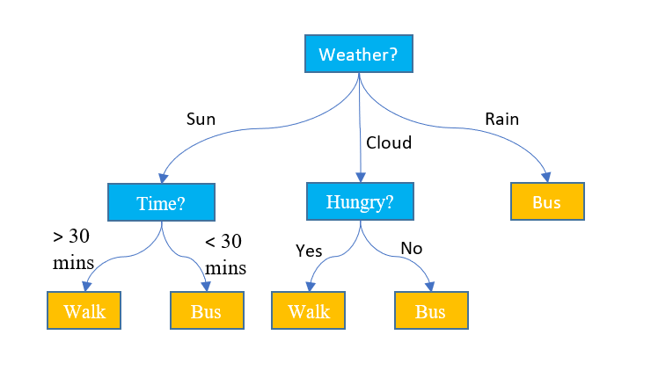
Decision trees learn simple decision rules to predict responses
Represented as an upside-down tree structure
Each internal node denotes a test on an attribute
Each branch represents an outcome of the test
Each leaf node (terminal node) holds a class label
Can be used for multi-class classification
Adapted from Decision Tree
Notes:
Decision trees are able to generate understandable rules.
Decision trees perform classification without requiring much computation.
Decision trees are able to handle both continuous and categorical variables.
Decision trees provide a clear indication of which fields are most important for prediction or classification.

Slide 13
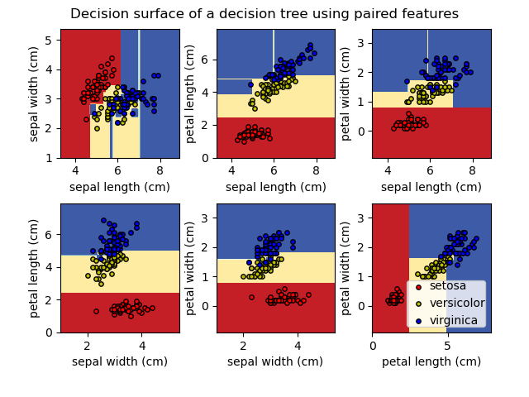
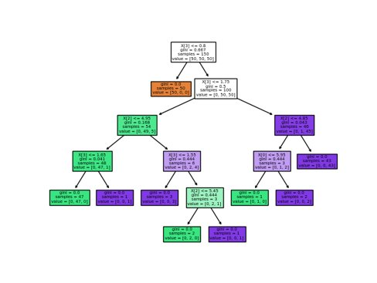
Classifying Iris species
Three species of Iris (Iris setosa, Iris virginica and Iris versicolor)
Features:
Sepal length
Sepal width
Petal length
Petal width
For each pair of iris features, the decision tree learns decision boundaries made of combinations of simple thresholding rules inferred from the training samples
Adapted from Decision Trees (scikit-learn)

Slide 14
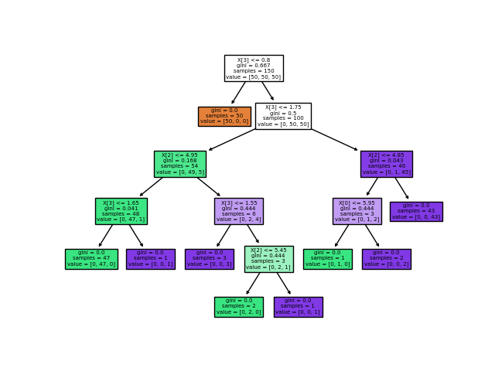
Classifying Iris species
Three species of Iris (Iris setosa, Iris virginica and Iris versicolor)
Features:
Sepal length
Sepal width
Petal length
Petal width
For each pair of iris features, the decision tree learns decision boundaries made of combinations of simple thresholding rules inferred from the training samples
Adapted from Decision Trees (scikit-learn)

Slide 15
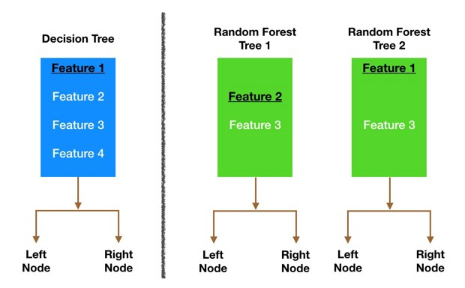
Random forest builds multiple decision trees and merges them together
Instead of searching for the most important feature while splitting a node, it searches for the best feature among a random subset of features
Bagging
Each individual tree randomly samples from the dataset with replacement, resulting in different trees
Adapted from A COMPLETE GUIDE TO THE RANDOM FOREST ALGORITHM , Understanding Random Forest
Notes:
only a random subset of the features is taken into consideration by the algorithm for splitting a node
very easy to measure the relative importance of each feature on the prediction
random forest prevents this by creating random subsets of the features and building smaller trees using those subsets. Afterwards, it combines the subtrees. It's important to note this doesn’t work every time and it also makes the computation slower, depending on how many trees the random forest builds

Slide 16
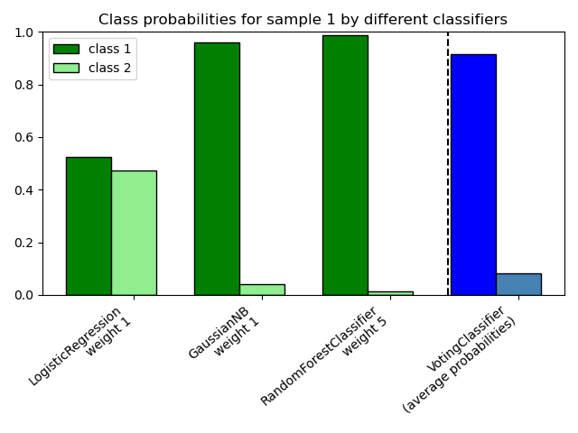
A voting ensemble combines predictions from multiple models
For classification, the predictions for each label are summed and the label with the majority vote is predicted
Hard Voting - predict the class with the largest sum of votes from models
Soft Voting - predict the class with the largest summed probability from models
Adapted from How to Develop Voting Ensembles With Python
Notes:
It is a technique that may be used to improve model performance, ideally achieving better performance than any single model used in the ensemble.

Slide 17
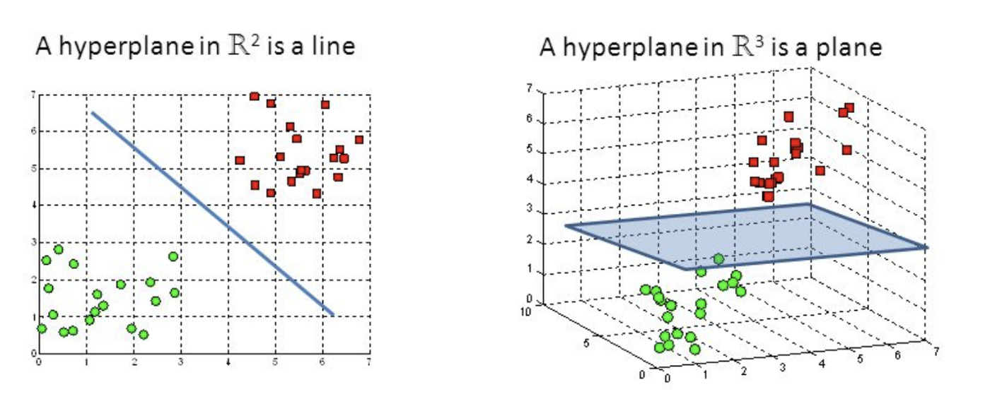
Support Vector Machines construct hyperplanes in high-dimensional space to classify data points
The objective is to find a decision surface in an N-dimensional space (N = the number of features) that has maximum distance between data points of both classes
Support vectors - data points that are closer to the hyperplane and influence the position and orientation of the hyperplane
Adapted from Support Vector Machine — Introduction to Machine Learning Algorithms

Slide 18
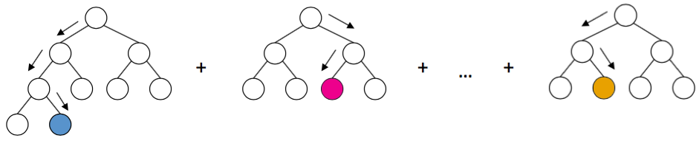
XGBoost is a tree-based method designed for speed and performance
Extreme Gradient Boosting
XGBoost is an implementation of gradient boosted decision trees
Boosting
Ensemble technique where new models are added to correct the errors made by existing models
Models are added sequentially until no further improvements can be made
Adapted from A Gentle Introduction to XGBoost for Applied Machine Learning
Notes:
The output of XGBoost is an ensemble of decision trees.
Each individual tree by itself is not very powerful, containing only a few branches. But through gradient boosting, each subsequent tree tries to correct for the mistakes of all the trees before it, and makes the model better.
After many iterations, we get a set of decision trees; the sum of the all their outputs is our final prediction

Slide 19
Coding Examples

